Slide 1


Slide 2
CSC 236
Tutorial finale - Daniel Razavi

Slide 3
Today’s Problem Set

Slide 4
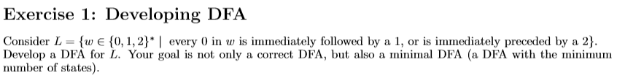

Slide 5
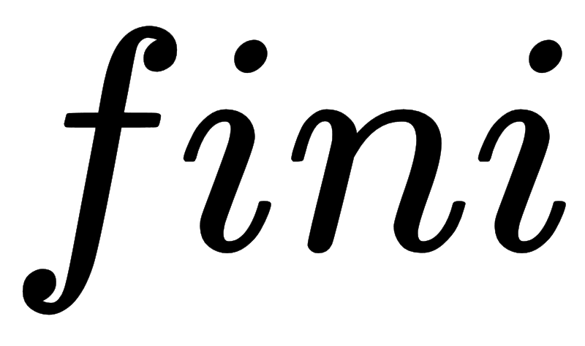
Current State | Symbol | New State
q0 | 0 | q1
q0 | 1 | q0
q0 | 2 | q2
q1 | 1 | q0
q1 | 0 | q3
q1 | 2 | q3
q2 | 0 | q0
q2 | 1 | q0
q2 | 2 | q2
q3 | 0 | q3
q3 | 1 | q3
q3 | 2 | q3
q0 is start state
{q0, q2} are accepting states.
1
START
q0
1
0, 1
2
q1
0
q2
0, 2
2
q3
0, 1, 2
Double Dash in my slides means that the state is an accepting state, couldn’t double line them nicely

Slide 6


Slide 7
Here are the state invariants:
1
START
q0: the string is empty; or the string has no bad 0s and ends with 1; or the string has no bad 0s and ends with 20
q0
1
0, 1
2
q1: the string has no bad 0s, the last symbol is 0, and the second-last symbol is not 2
q1
0
q2
2
q2: the string has no bad 0s, and the last symbol is 2
0, 2
q3
0, 1, 2
q3: the string contains at least one bad 0
Double Dash in my slides means that the state is an accepting state, couldn’t double line them nicely

Slide 8
1
This covers all strings over the alphabet; and no string satisfies multiple invariants.
To prove correctness, we begin with the base case, and show that epsilon satisfies the invariant for q0.
It does, because the empty string is explicitly given as a string that satisfies the invariant for q0.
START
q0
1
0, 1
2
q1
0
q2
0, 2
2
q3
0, 1, 2
Double Dash in my slides means that the state is an accepting state, couldn’t double line them nicely

Slide 9
This covers all strings over the alphabet; and no string satisfies multiple invariants.
To prove correctness, we begin with the base case, and show that epsilon satisfies the invariant for q0.
It does, because the empty string is explicitly given as a string that satisfies the invariant for q0.
1
START
q0
Now for each transition
q, a, r
we show that if the invariant q holds for string w, then the invariant r holds for string wa.
We do this separately for each transition in the transition table.
1
0, 1
2
q1
0
q2
0, 2
2
q3
0, 1, 2
Double Dash in my slides means that the state is an accepting state, couldn’t double line them nicely

Slide 10
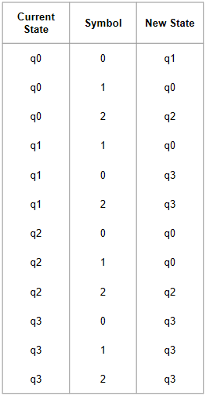
This covers all strings over the alphabet; and no string satisfies multiple invariants.
To prove correctness, we begin with the base case, and show that epsilon satisfies the invariant for q0.
It does, because the empty string is explicitly given as a string that satisfies the invariant for q0.
Now for each transition
q, a, r
we show that if the invariant q holds for string w, then the invariant r holds for string wa.
We do this separately for each transition in the transition table.
1
START
q0
q0,0,q1: appending the 0 yields a string that ends with 0, as required by the q1 invariant.
We also require that the second-last symbol is NOT 2, which follows from the q0 invariant (the last symbol is a 0 or 1).
Finally, we require that the new string has no bad 0s; the only possible bad 0 would be a 0 at the end of the string prior to appending the 0. But that cannot be a bad 0, as (according to the q1 invariant) that 0 would have been preceded by a 2. (We use this argument implicitly in the next two transitions as well.)
1
0, 1
2
q1
0
q2
0, 2
2
q3
0, 1, 2
Double Dash in my slides means that the state is an accepting state, couldn’t double line them nicely

Slide 11
This covers all strings over the alphabet; and no string satisfies multiple invariants.
To prove correctness, we begin with the base case, and show that epsilon satisfies the invariant for q0.
It does, because the empty string is explicitly given as a string that satisfies the invariant for q0.
Now for each transition
q, a, r
we show that if the invariant q holds for string w, then the invariant r holds for string wa.
We do this separately for each transition in the transition table.
1
START
q0
1
0, 1
q0,1,q0: the string has no bad 0s; adding a 1 creates no new bad 0s, and the string ends with 1
2
q1
0
q2
0, 2
2
q3
0, 1, 2
Double Dash in my slides means that the state is an accepting state, couldn’t double line them nicely

Slide 12
This covers all strings over the alphabet; and no string satisfies multiple invariants.
To prove correctness, we begin with the base case, and show that epsilon satisfies the invariant for q0.
It does, because the empty string is explicitly given as a string that satisfies the invariant for q0.
Now for each transition
q, a, r
we show that if the invariant q holds for string w, then the invariant r holds for string wa.
We do this separately for each transition in the transition table.
1
START
q0
1
0, 1
q0,1,q0: the string has no bad 0s; adding a 1 creates no new bad 0s, and the string ends with 1
2
q1
0
q2
0, 2
2
You get the idea? Because ...
q3
0, 1, 2
Double Dash in my slides means that the state is an accepting state, couldn’t double line them nicely

Slide 13
1
START
q0,2,q2: the string has no bad 0s; adding 2 yields no bad 0s, and the string ends with 2
q1,1,q0: the string ends with 10 or 00 and has no bad 0s; adding 1 gives 101 or 001, and these strings have no bad 0s and end with 1. The string could also be 0; adding 1 yields 01, which has no bad 0s and ends with 1.
q1,0,q3: the string ends with 10 or 00; adding 0 gives 100 or 000, both of which have a bad 0. Or, the string is 0; adding a 0 gives 00, and the first 0 is a bad 0.
q1,2,q3: the string ends with 10 or 00; adding 2 gives 102 or 002, both of which have a bad 0. Or, the string is 0; adding a 2 gives 02, and the 0 is a bad 0.
q2,0,q0: the string has no bad 0s and ends with a 2; adding a 0 can't introduce any bad 0s (it has no symbol following it), and now the string ends with 20
q2,1,q0: the string has no bad 0s and ends with a 2; adding a 1 can't introduce any bad 0s, and now the string ends with 1
q2,2,q2: The string has no bad 0s and ends with a 2; adding a 2 to the end can't introduce any bad 0s and yields a string that still ends with 2
q3,0,q3 and q3,1,q3 and q3,2,q3: These three transitions are the easy ones. The string contains at least one bad 0, so whatever we add to it yields a string that still has at least one bad 0.
q0
1
0, 1
0
2
q1
q2
0, 2
2
q3
0, 1, 2
Double Dash in my slides means that the state is an accepting state, couldn’t double line them nicely

Slide 14
q0,2,q2: the string has no bad 0s; adding 2 yields no bad 0s, and the string ends with 2
q1,1,q0: the string ends with 10 or 00 and has no bad 0s; adding 1 gives 101 or 001, and these strings have no bad 0s and end with 1. The string could also be 0; adding 1 yields 01, which has no bad 0s and ends with 1.
q1,0,q3: the string ends with 10 or 00; adding 0 gives 100 or 000, both of which have a bad 0. Or, the string is 0; adding a 0 gives 00, and the first 0 is a bad 0.
q1,2,q3: the string ends with 10 or 00; adding 2 gives 102 or 002, both of which have a bad 0. Or, the string is 0; adding a 2 gives 02, and the 0 is a bad 0.
q2,0,q0: the string has no bad 0s and ends with a 2; adding a 0 can't introduce any bad 0s (it has no symbol following it), and now the string ends with 20
q2,1,q0: the string has no bad 0s and ends with a 2; adding a 1 can't introduce any bad 0s, and now the string ends with 1
q2,2,q2: The string has no bad 0s and ends with a 2; adding a 2 to the end can't introduce any bad 0s and yields a string that still ends with 2
q3,0,q3 and q3,1,q3 and q3,2,q3: These three transitions are the easy ones. The string contains at least one bad 0, so whatever we add to it yields a string that still has at least one bad 0.
1
START
Double Dash in my slides means that the state is an accepting state, couldn’t double line them nicely
q0
1
0, 1
2
q3 cannot be an accepting state as it has at least one bad 0.
q1 has a 0 at the end and so cannot be an accepting state.
q0 and q2 have no bad 0s and do not end with a 0, and so are the accepting states.
Therefore the DFA is correct.
q1
0
q2
0, 2
2
q3
0, 1, 2

Slide 15


Slide 16

1
START
q0
Our DFA has 4 states
we prove that 4 states is minimal by exhibiting 4 strings where each pair of strings leads to a contradiction.
(pigeonhole principle)
Here are 4 suitable strings:
0, 1, 2, 00
1
0, 1
2
q1
0
q2
0, 2
2
q3
0, 1, 2
Double Dash in my slides means that the state is an accepting state, couldn’t double line them nicely

Slide 17
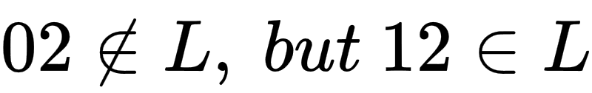
Our DFA has 4 states
we prove that 4 states is minimal by exhibiting 4 strings where each pair of strings leads to a contradiction.
Here are 4 suitable strings:
0, 1, 2, 00
1
START
q0
0 and 1 are distinguished by the suffix 2:
(note: strings with no 0's are all in L).
1
0, 1
2
q1
0
q2
0, 2
2
q3
0, 1, 2
Double Dash in my slides means that the state is an accepting state, couldn’t double line them nicely

Slide 18
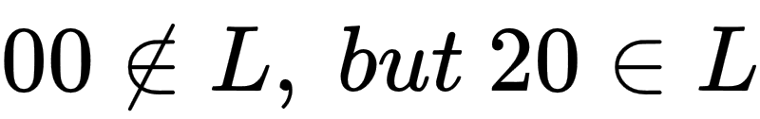
Our DFA has 4 states
we prove that 4 states is minimal by exhibiting 4 strings where each pair of strings leads to a contradiction.
Here are 4 suitable strings:
0, 1, 2, 00
1
START
q0
0 and 2 are distinguished by the suffix 0:
(the 0 is preceded by a 2).
1
0, 1
2
q1
0
q2
0, 2
2
q3
0, 1, 2
Double Dash in my slides means that the state is an accepting state, couldn’t double line them nicely

Slide 19
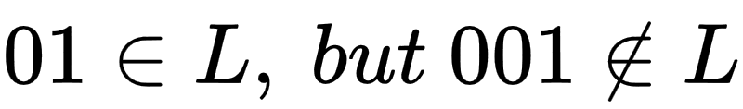
Our DFA has 4 states
we prove that 4 states is minimal by exhibiting 4 strings where each pair of strings leads to a contradiction.
Here are 4 suitable strings:
0, 1, 2, 00
1
START
q0
0 and 00 are distinguished by the suffix 1:
(the first 0 isn't followed by a 1 or preceded by a 2).
1
0, 1
2
q1
0
q2
0, 2
2
q3
0, 1, 2
Double Dash in my slides means that the state is an accepting state, couldn’t double line them nicely

Slide 20
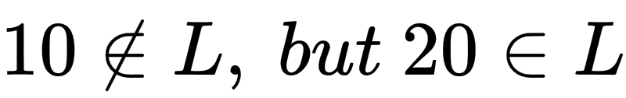
Our DFA has 4 states
we prove that 4 states is minimal by exhibiting 4 strings where each pair of strings leads to a contradiction.
Here are 4 suitable strings:
0, 1, 2, 00
1
START
q0
1 and 2 are distinguished by the suffix 0:
1
0, 1
2
q1
0
q2
0, 2
2
q3
0, 1, 2
Double Dash in my slides means that the state is an accepting state, couldn’t double line them nicely

Slide 21
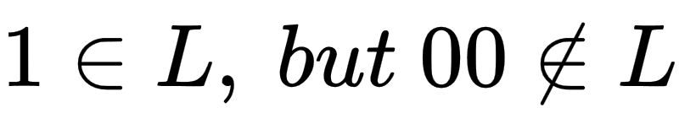
Our DFA has 4 states
we prove that 4 states is minimal by exhibiting 4 strings where each pair of strings leads to a contradiction.
Here are 4 suitable strings:
0, 1, 2, 00
1
START
q0
1 and 00 are distinguished by the suffix epsilon:
Note: if you don't like epsilon as a suffix, try the string 1 or 11 instead.
1
0, 1
2
q1
0
q2
0, 2
2
q3
0, 1, 2
Double Dash in my slides means that the state is an accepting state, couldn’t double line them nicely

Slide 22
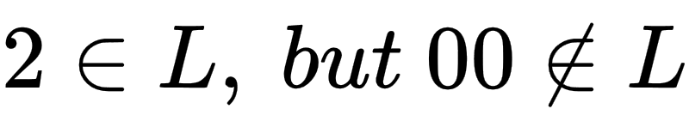
Our DFA has 4 states
we prove that 4 states is minimal by exhibiting 4 strings where each pair of strings leads to a contradiction.
Here are 4 suitable strings:
0, 1, 2, 00
1
START
q0
2 and 00 are distinguished by the suffix epsilon:
1
0, 1
2
q1
0
q2
0, 2
2
q3
0, 1, 2
Double Dash in my slides means that the state is an accepting state, couldn’t double line them nicely

Slide 23
Thank you for the Opportunity

Slide 24
dnlrzv

Slide 25
CSC 236
Tutorial 10 - Daniel Razavi

